Slide 1
 | Fully vs Partially Observable | Deterministic vs Stochastic | Episodic vs Sequential | Static vs Dynamic | Discrete vs Continuous | Single vs Multi Agents | Known vs unknown | Competitive vs Cooperative
Agents from Book
3

Slide 2
MDP Tuple
M=(S,A,P,R)
S = set of possible states
A = set of possible actions
P(sʼ|s,a) gives transition probabilities
R = reward function
Goal: find an optimal policy, π*

Slide 3
State, Action, Transition Function, Policy, Reward
Policy: What action to take based on the current state or location. The policy (strategy) maps the current environment observation to a probability distribution of actions to be taken.
Reward : The reward signal measures the performance of the agent with respect to the task goals. For a given observation (state), the reward measures the effectiveness of taking a particular action.

Slide 4
Reward and Utility
A reward function is defined over past sequences of actions and observations. When the agent chooses an action, and gets an observation, they receive a reward that is a function of that observation and all previous observations and actions.
A utility function is defined over states of the world. You can take actions to increase or decrease the probability of certain states, thus increasing expected utility, but you don't actually "receive" any utility.
For finite horizon (ends in N steps) utility might be used as reward.

Slide 5
Reward and Utility
Utility = long term total reward from s onwards
Reward = short term reward from s

Slide 6
Agent's Utility Function
Performance depends on the entire sequence of states and actions.
“Environment history”
In each state, the agent receives a reward R(s).
The reward is real-valued. It may be positive or negative.
Utility of environment history = sum of reward received.

Slide 7
Goal
Find the policy that maximizes the expected sum of rewards, called an optimal policy.

Slide 8
Policy vs Value Iteration
Policy iteration includes: policy evaluation + policy improvement, and the two are repeated iteratively until policy converges.
Value iteration includes: finding optimal value function + one policy extraction. There is no repeat of the two because once the value function is optimal, then the policy out of it should also be optimal (i.e. converged).

Slide 9
Quiz Game Show
In a quiz game show there are 10 levels, at each level
one question is asked and if answered correctly a
certain monetary reward based on the current level is
given. Higher the level, tougher the question but higher the reward.
States: {level1, level2, …, level10}
Actions: Play at next level or quit
At each round of play, if the participant answers the
quiz correctly then s/he wins the reward and also gets • Rewards: Play at level1, level2, …,
to decide whether to play at the next level or quit. If quit then the participant gets to keep all the rewards earned so far. At any round if participants failed to answer correctly then s/he looses “all” the rewards earned so far. The game stops at level 10. The goal is to decide on the actions to play or quit maximizing total rewards.
level10 generates rewards $10, $50,
$100, $500, $1000, $5000, $10000,
$50000, $100000, $500000 with
probability p = 0.99, 0.9, 0.8, …, 0.2,
0.1 respectively. The probability here is a the probability of giving correct answer in that level. At any level, the participant losses with probability (1- p) and losses all the rewards earned so far.

Slide 10
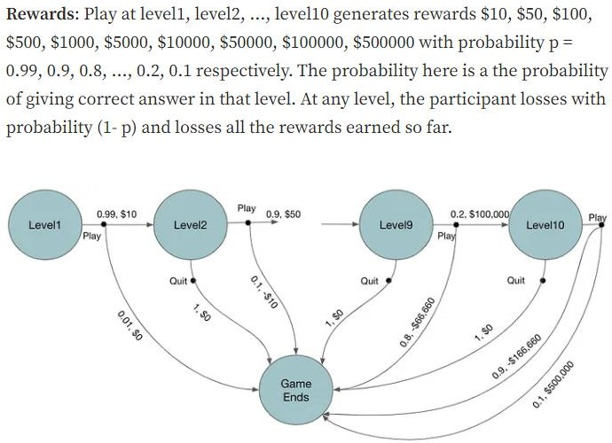

Slide 11
We can see that for the action play, there are two possible transitions,
won which transitions to next level with probability p and the reward amount of the current level
lost which ends the game with probability (1-p) and losses all the rewards earned so far. Action quit ends the game with probability 1 and no rewards.

Slide 12
States: The number of salmons available in that area in that year. For simplicity assume there are only four states; empty, low, medium, high. The four states are defined as follows
Empty -> no salmons are available; low -> available number of salmons are below a certain threshold t1; medium -> available number of salmons are between t1and t2; high -> available number of salmons are more than t2
Actions: For simplicity assumes there are only two actions; fish and not_to_fish. Fish means catching certain proportions of salmon. For the state empty the only possible action is not_to_fish.
Rewards: Fishing at certain state generates rewards, let’s assume the rewards of fishing at state low, medium and high are $5K, $50K and $100k respectively. If an action takes to empty state then the reward is very low -$200K as it require re-breeding new salmons which takes time and money.
State Transitions: Fishing in a state has higher a probability to move to a state with lower number of salmons. Similarly, not_to_fish action has higher probability to move to a state with higher number of salmons (excepts for the state high).
Current State (s) | Action (a) | Next State (s′) | Probability P(s′∣s,a) | Reward R(s,a,s′)
Empty | Not-to-fish | Low | $0.9$ | $0$
 |  | Empty | $0.1$ | $0$
Low | Fish | Empty | $0.8$ | $-\$200K$
 |  | Low | $0.2$ | $+\$5K$
Low | Not-to-fish | Medium | $0.8$ | $0$
 |  | Low | $0.2$ | $0$
Medium | Fish | Low | $0.7$ | $+\$50K$
 |  | Medium | $0.3$ | $+\$50K$
Medium | Not-to-fish | High | $0.8$ | $0$
 |  | Medium | $0.2$ | $0$
High | Fish | Medium | $0.7$ | $+\$100K$
 |  | High | $0.3$ | $+\$100K$
High | Not-to-fish | High | $0.9$ | $0$
 |  | Medium | $0.1$ | $0$

Slide 13
Transition Probabilities ?
Either given or Programmer's choice based on the problem statement of finding the optimal policies.
Based on the above problem imagine you are trying to achieve a long-term stable ecosystem balancing current fishing situation.
How to find the optimal policy [policy that maximizes the expected sum of rewards] for that ?

Slide 14
Other Parameters
While designing the agent apart from the MDP tuple we need :
To tell the AI that how much we care for future rewards along with the current reward to achieve based on the problem statement. This is the discount factor, denoted by Gamma. Value of Gamma is 0 to 1, if Gamma is 0 agent cares about only immediate rewards , if 1 understands future actions are critical. Gamma values for a typical problem ranges from 0.2-0.9.
Telling AI to stop iterating after once the "value" of the states changes by less than the Bellman function value. Denoted by Epsilon – stopping criteria.

Slide 15
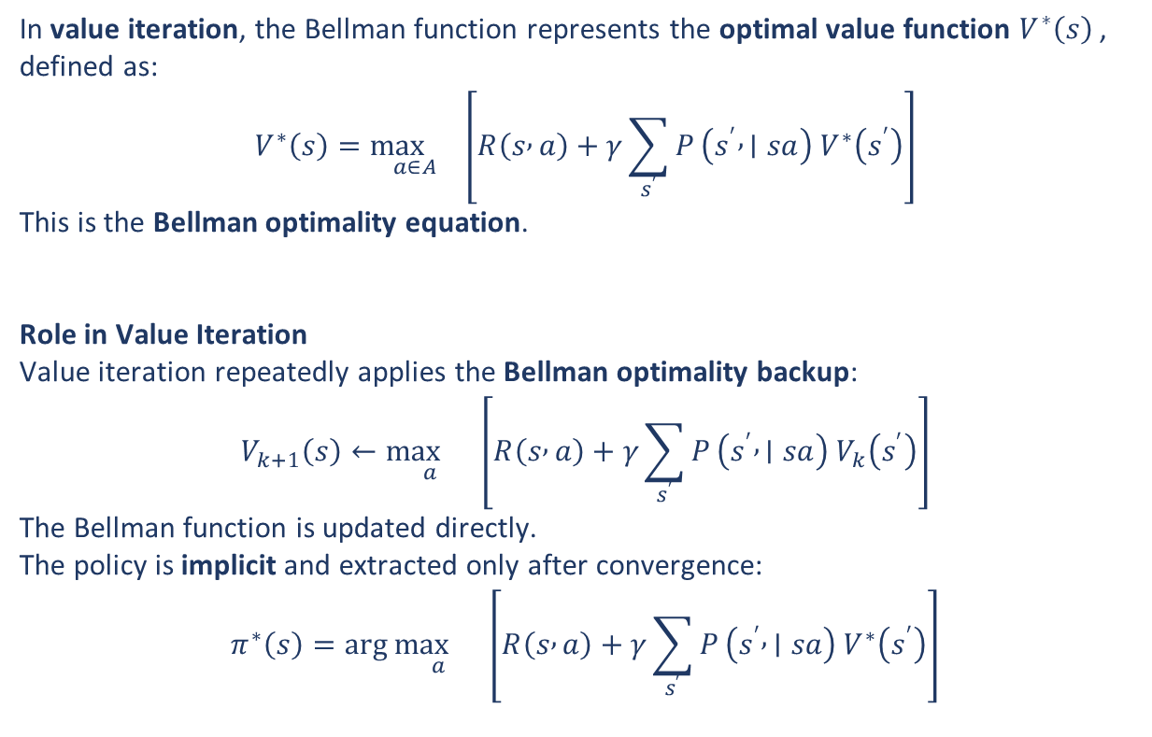
What is Bellman function – Value iteration?
In value iteration, the Bellman function represents the optimal value function $V^{∗}\left(s\right)$, defined as:
$$V^{∗}\left(s\right)=\underset{a∈A}{\max{}}\left[R\left(s , a\right)+γ\sum_{s^{′}}{P}\left(s^{′} , ∣sa\right) V^{∗}\left(s^{′}\right)\right]$$
This is the Bellman optimality equation.
Role in Value Iteration
Value iteration repeatedly applies the Bellman optimality backup:
$$V_{k+1}\left(s\right)←\underset{a}{\max{}}\left[R\left(s , a\right)+γ\sum_{s^{′}}{P}\left(s^{′} , ∣sa\right) V_{k}\left(s^{′}\right)\right]$$
The Bellman function is updated directly.
The policy is implicit and extracted only after convergence:
$$π^{∗}\left(s\right)=\arg{\underset{a}{\max{}}}\left[R\left(s , a\right)+γ\sum_{s^{′}}{P}\left(s^{′} , ∣sa\right) V^{∗}\left(s^{′}\right)\right]$$
𝛾 → discount factor
P → Transition Probabilities: P[state][action][next_state]

Slide 16
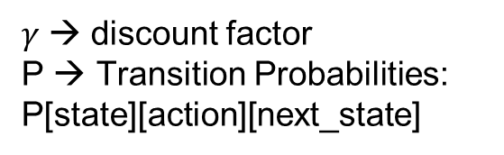
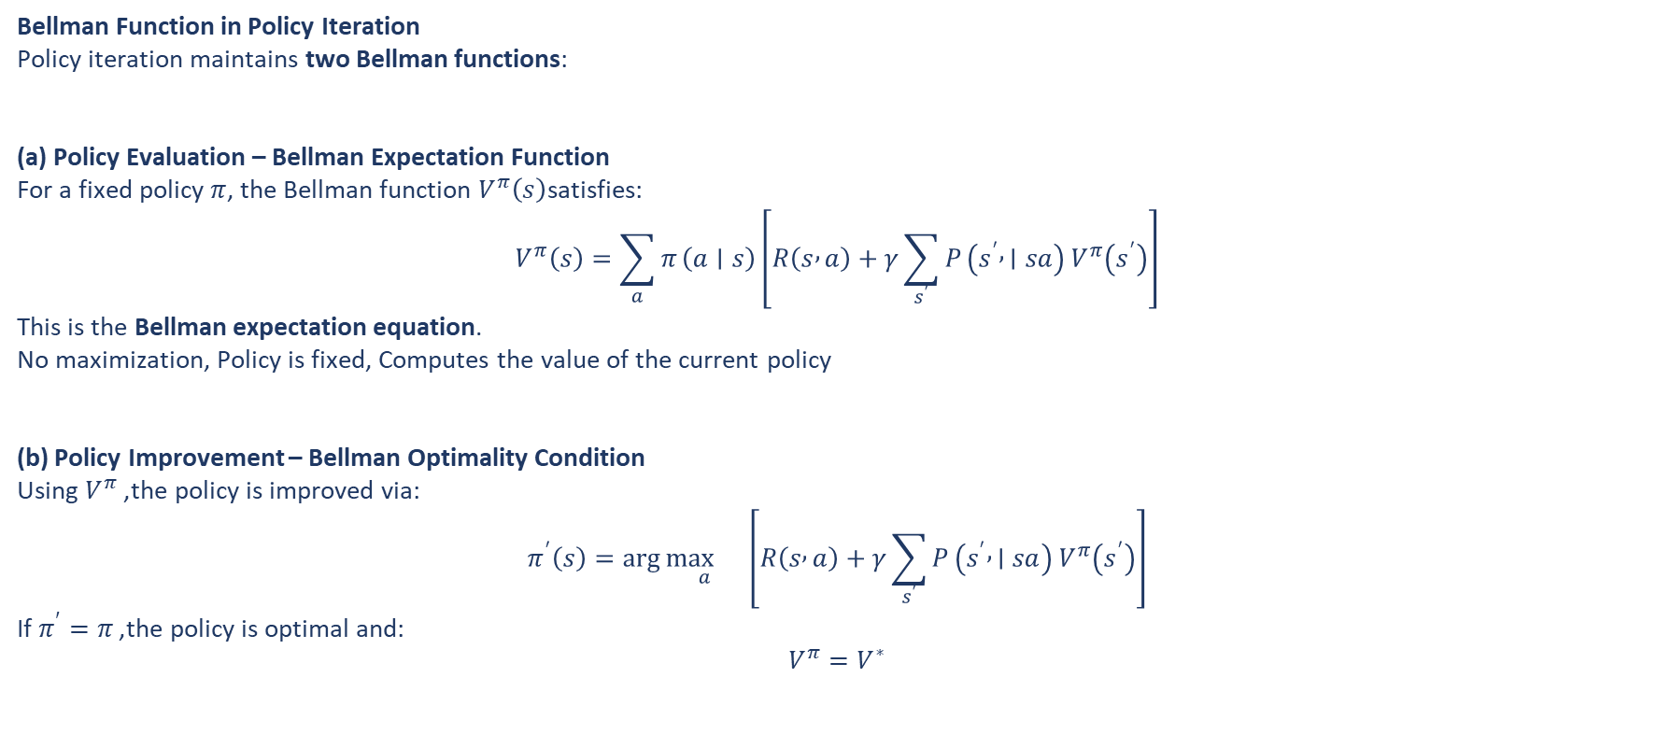
What is Bellman function – Policy iteration ?
Bellman Function in Policy Iteration
Policy iteration maintains two Bellman functions:
(a) Policy Evaluation – Bellman Expectation Function
For a fixed policy $π$, the Bellman function $V^{π}\left(s\right)$satisfies:
$$V^{π}\left(s\right)=\sum_{a}{π}\left(a∣s\right)\left[R\left(s , a\right)+γ\sum_{s^{′}}{P}\left(s^{′} , ∣sa\right) V^{π}\left(s^{′}\right)\right]$$
This is the Bellman expectation equation.
No maximization, Policy is fixed, Computes the value of the current policy
(b) Policy Improvement – Bellman Optimality Condition
Using $V^{π}$, the policy is improved via:
$$π^{′}\left(s\right)=\arg{\underset{a}{\max{}}}\left[R\left(s , a\right)+γ\sum_{s^{′}}{P}\left(s^{′} , ∣sa\right) V^{π}\left(s^{′}\right)\right]$$
If $π^{′}=π$, the policy is optimal and:
$$V^{π}=V^{∗}$$

